Slide 1
Week 2
A recap of Week 1

Slide 2
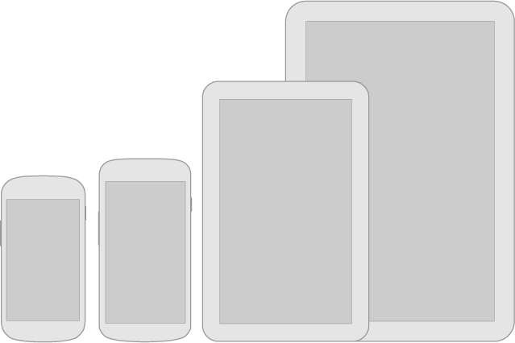
Android Screens

Slide 3
Responsive Frameworks
Jquery -jquery.com
Jquery mobile -jquerymobile.com
Foundation - http://foundation.zurb.com/
Skeleton -http://www.getskeleton.com/

Slide 4
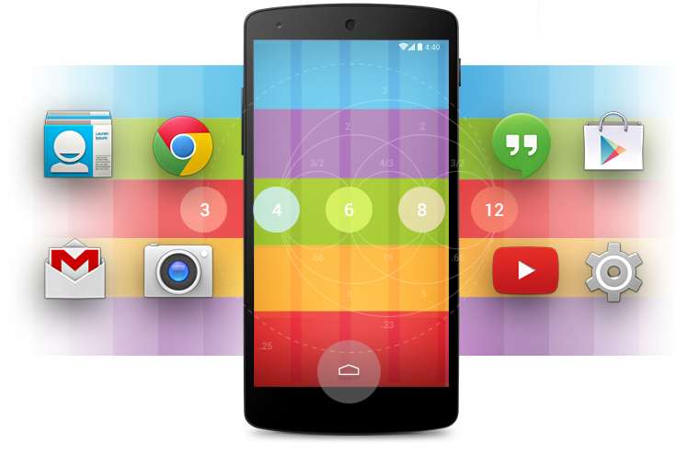
Colour Schemes

Slide 5
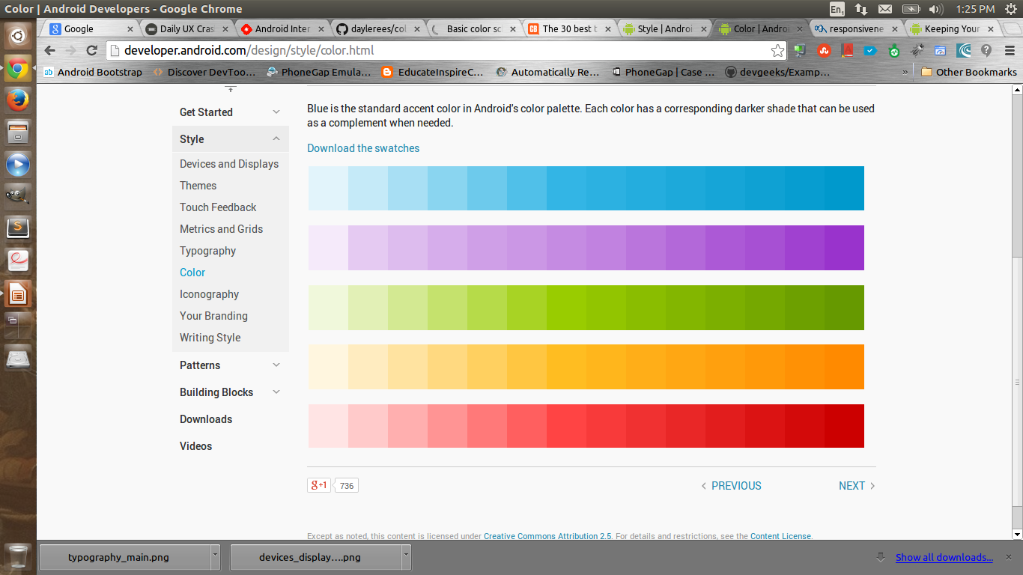
Colour Palettes and Swatches
developer.android.com
checkmycolours.com
colourexplorer.com

Slide 6
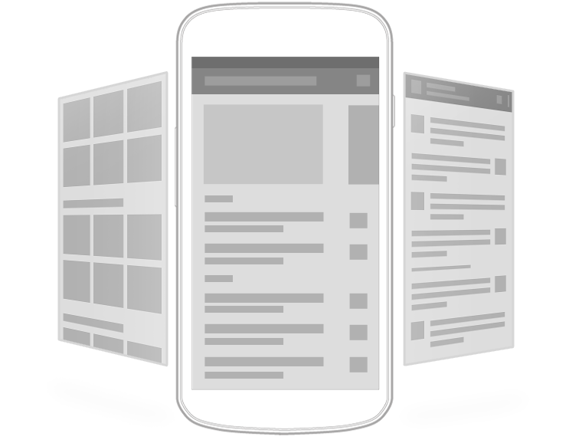
Design Patterns

Slide 7
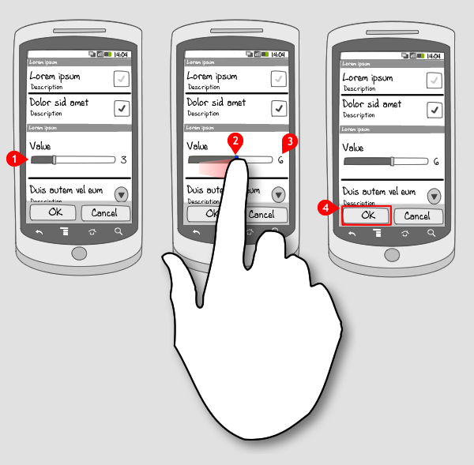
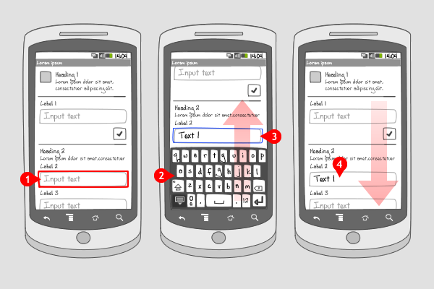
Capturing Input

Slide 8
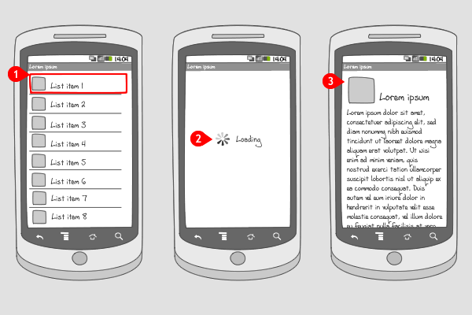
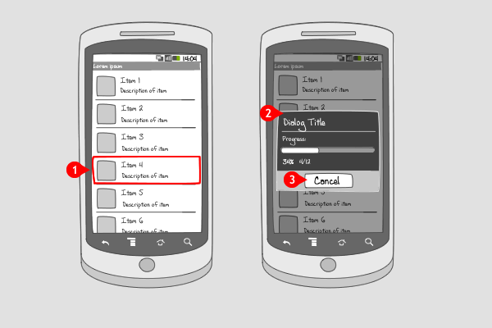
Notifications

Slide 9
Consistency
Predictability
Affordance

Slide 10
UX
What is UX?
  “doing” the process of User Experience Design.
  A user’s individual experience is their conscious, subjective opinion of your app or site.
Doing UX
  research to understand the users
  develop ideas to solve the users’ needs
  build and measure those solutions in the real world to see if they work.

Slide 11
Main Ingredients of UX
Psychology
  How much work does the user have to do to get what they want?
  What do they expect when they click this?
  Are you thinking of the user’s wants and needs, or your own?
Usability
  Are there any user mistakes you could prevent? (Hint: Yes, there are.)
  Have you provided everything the user needs to know?
  Could you get the job done with less input from the user?

Slide 12
Ingredients
Design
  Do users think it looks good? Do they trust it immediately?
  Do the colours, shapes, and typography help people find what they want and improve usability of the details?
Copy writing
Analysis

Slide 13
User Stories
Describes:
    one possible path a user can take on your site or app
It should be short, but complete.
Sample user story
  The user arrives on the main search page.
  The user can enter any search query and submit with the mouse or keyboard.
  The next page displays a list of search results with the most relevant results on top.
  he user can click the link to go to the appropriate site, or they can navigate through more pages of results until they find something useful.

Slide 14
Information Architecture
Types
  Categories(Types of content.)
  Tasks(actionable items)
  Search(complexity,user-generated content eg.youtube)
  Time(“hot right now, archived, later, new”-email)
  People(who the information is about,facebook)

Slide 15
Wire-frames
its an important step in any screen design process. It primarily allows you to define the information hierarchy of your design, making it easier for you to plan the layout according to how you want your user to process the information.

Slide 16
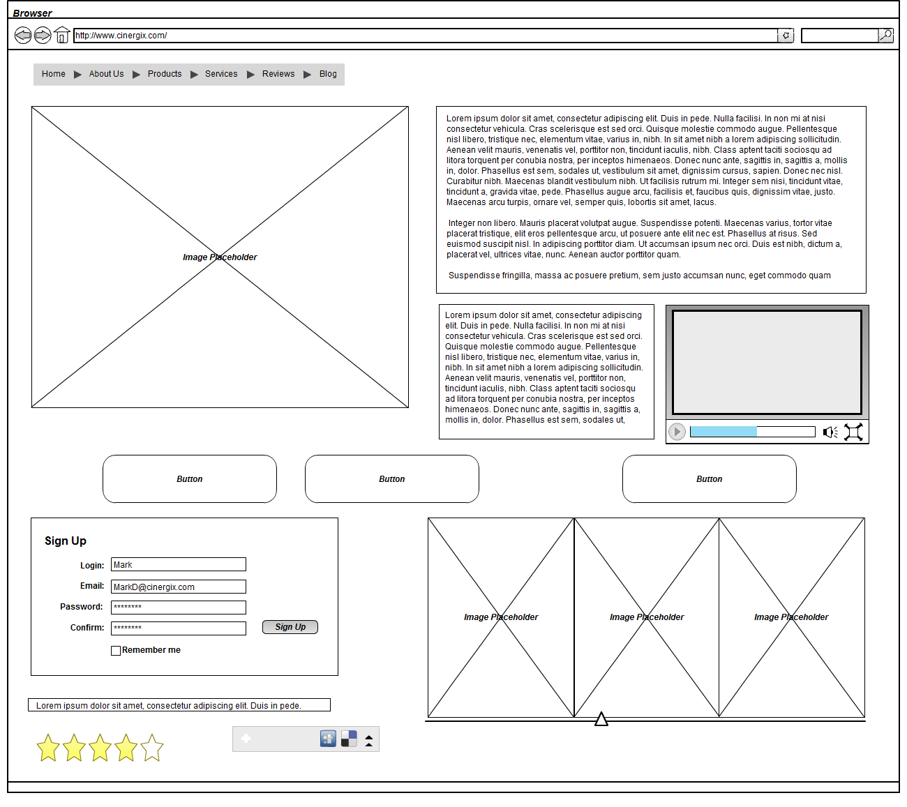

Slide 17
The end
Resource
  http://thehipperelement.com/post/73103991460/daily-ux-crash-course-12-of-31

